Slide 1
Mid-Semester Presentation
Ryan Li, Alvin Tan
Quant SC

Slide 2
AGENDA
01
PURPOSE
02
METHODOLOGY
03
DATASET
04
FUTURE DIRECTIONS

Slide 3
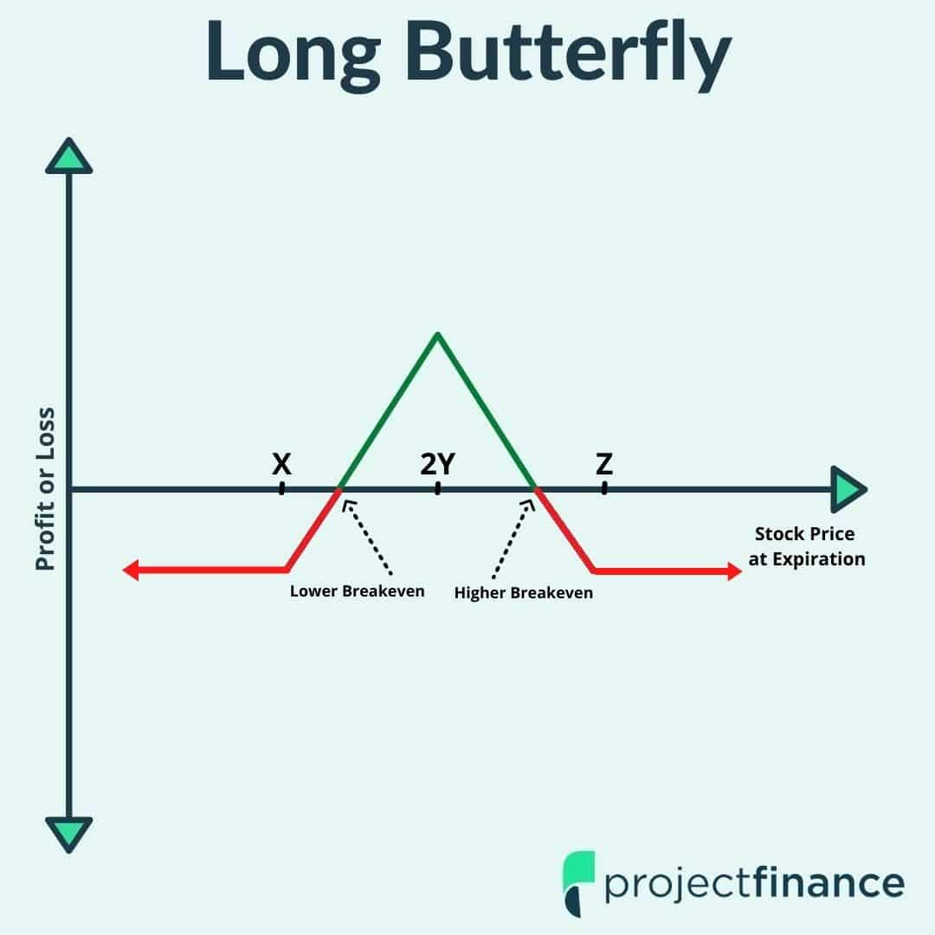
PURPOSE
Develop a options trading strategy that profits from implied volatility mispricings.
Process:
Realized volatility forecasting model
IV vs. RV comparison
Use strategies like butterfly or long straddle to bet on volatility

Slide 4

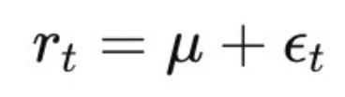
Methodology
GARCH Model
Generalized Autoregressive Conditional Heteroskedasticity Model
GARCH (1,1):
Predicts conditional variance for a given day using:
Long-term average volatility
Previous squared shock
Previous conditional variance
Drawbacks:
Daily returns are noisy measures of volatility
Multi-step forecasting depend on unobservable shocks
BAR GRAPH INFO 1
BAR GRAPH INFO 1
BAR GRAPH INFO 1

Slide 5
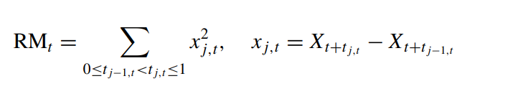
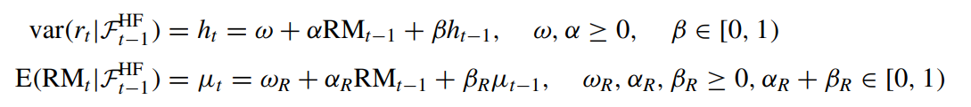
Methodology
HEAVY Model
High-frEquency-bAsed VolatilitY Model
Replaces epsilon (daily shock) by realized measure (using realized variance as RM for implementation)
Forecasting RM enables more reliable long-term forecasting
Less random noise:
Aggregating small pieces of information
Smoothing
BAR GRAPH INFO 1
BAR GRAPH INFO 1
BAR GRAPH INFO 1
BAR GRAPH INFO 1

Slide 6
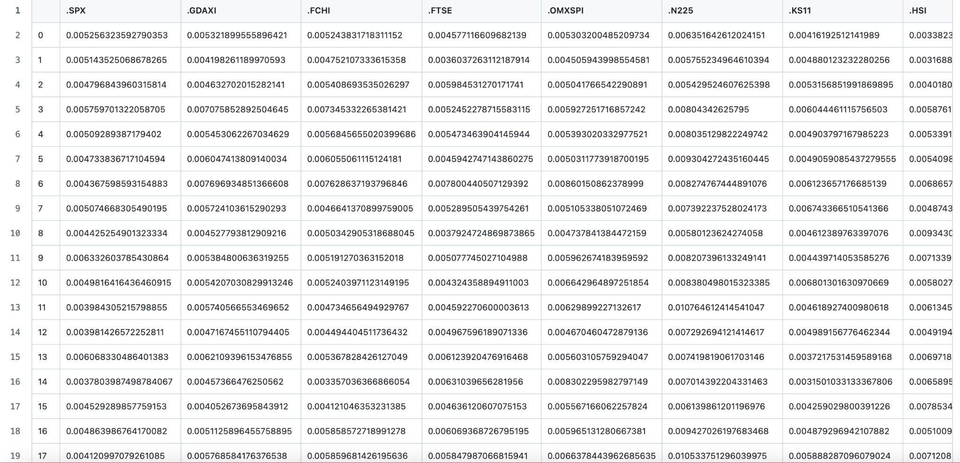
Dataset
5-min RV data for 8 ETFs
2000+ rows (~35 days)

Slide 7
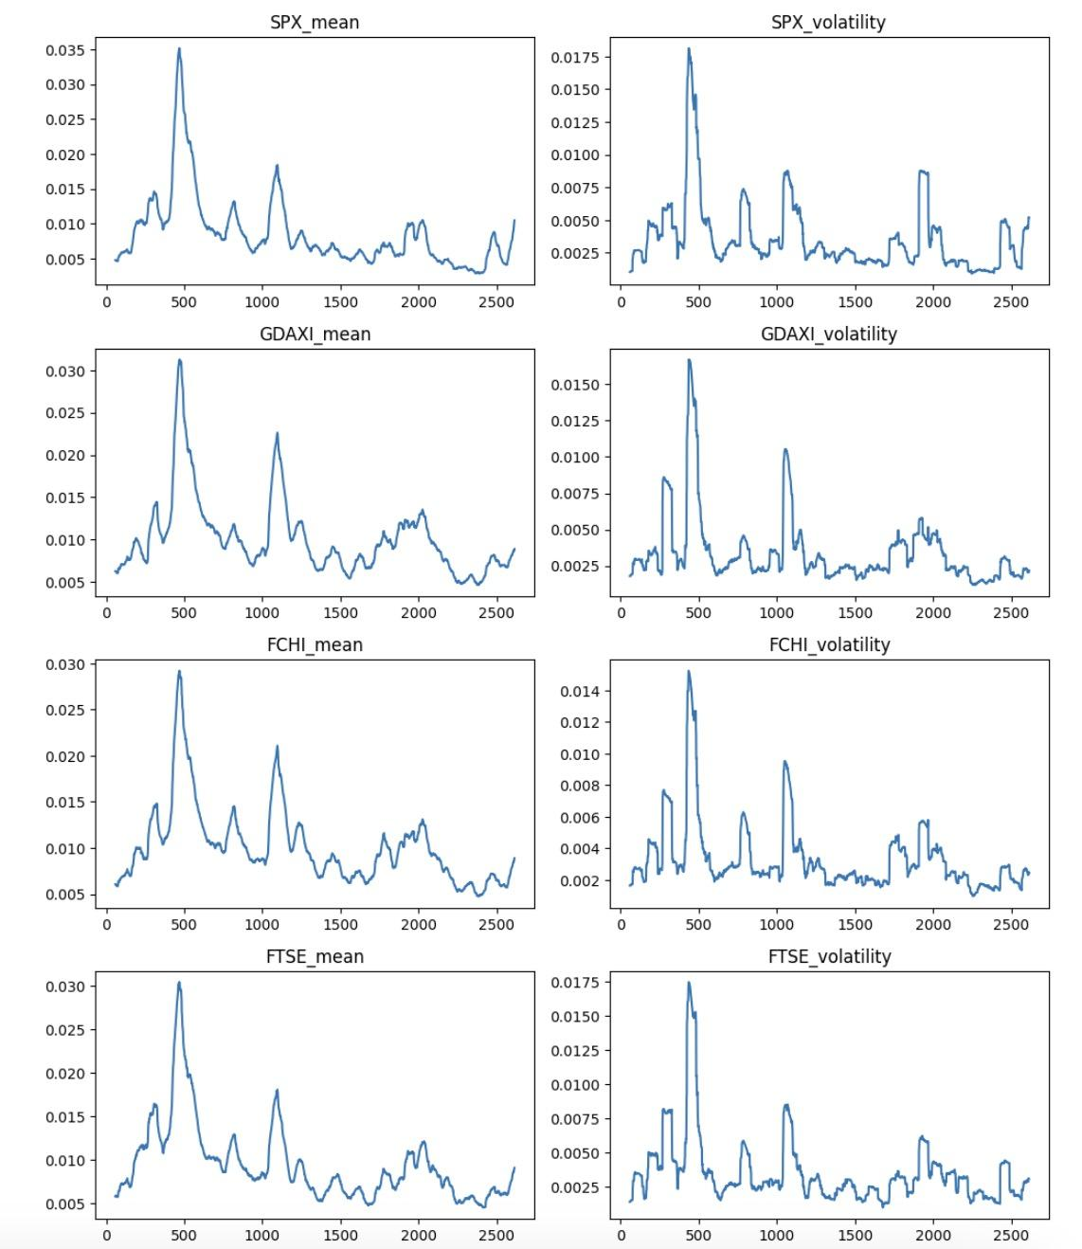
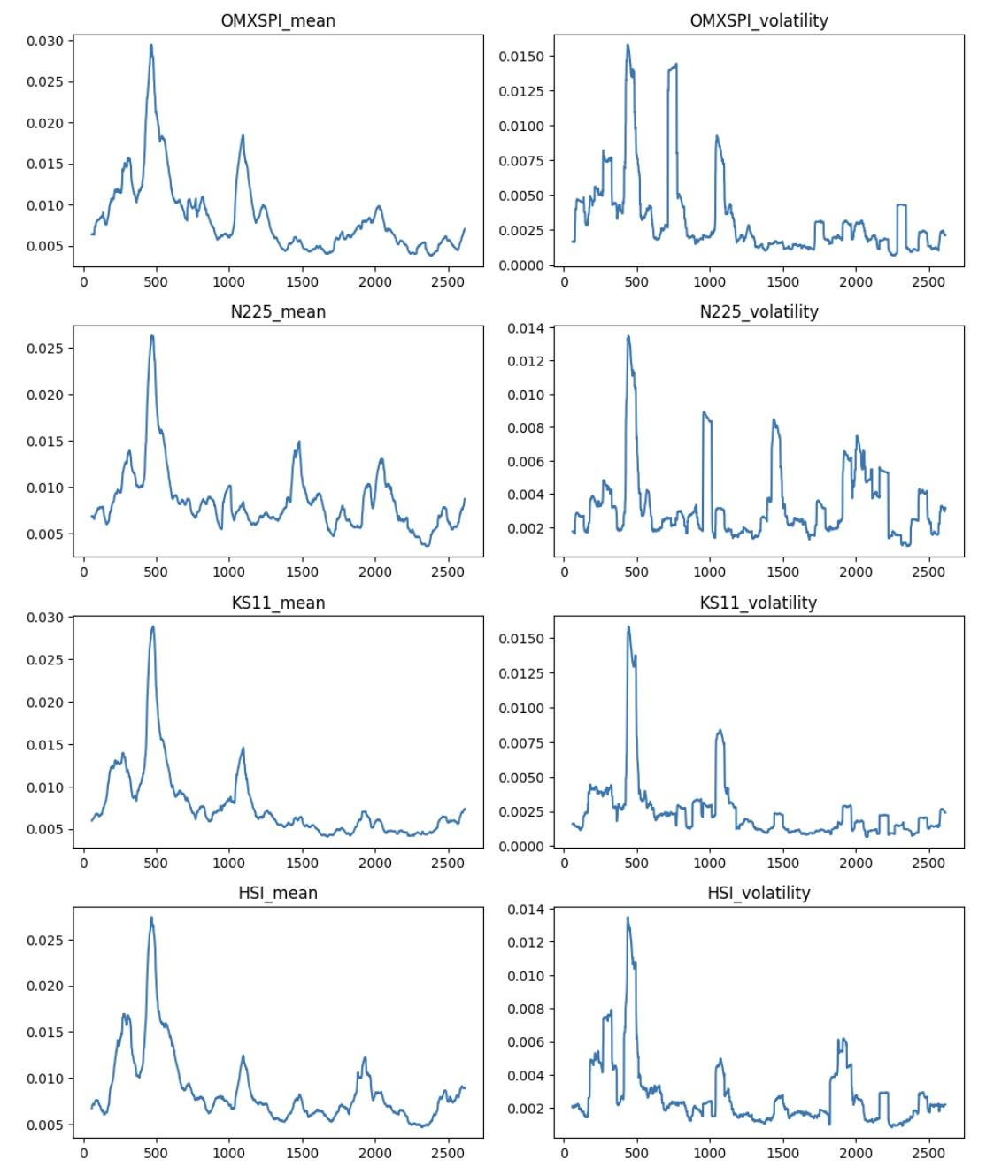
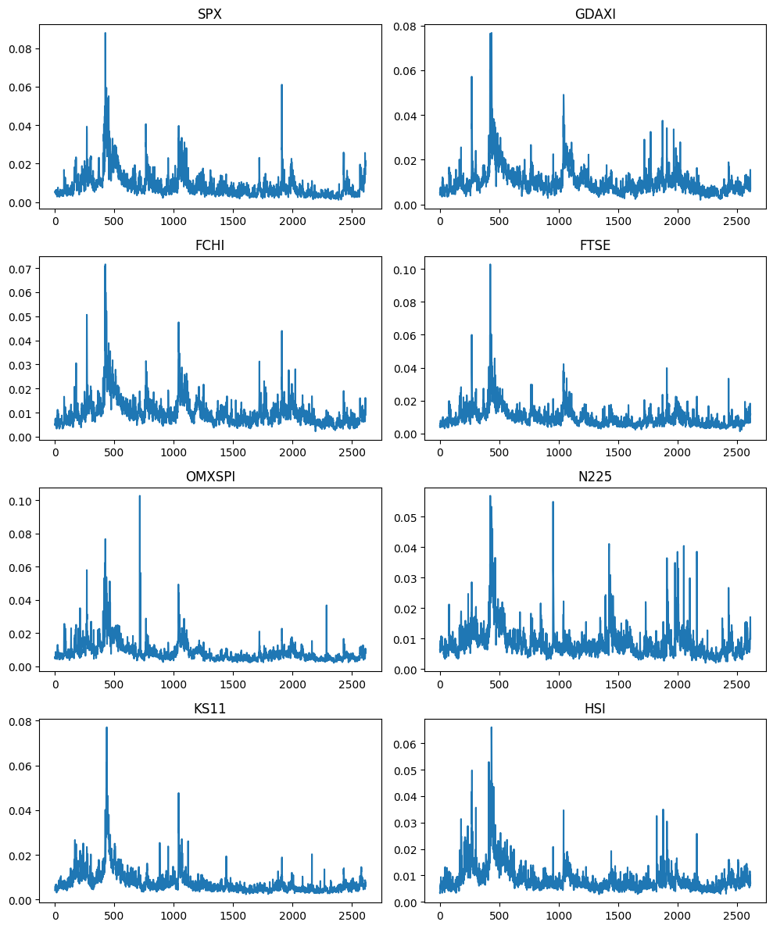
Dataset
Sliding Window (60) Mean and Volatility of RV
Realized Variance of Global ETFs

Slide 8
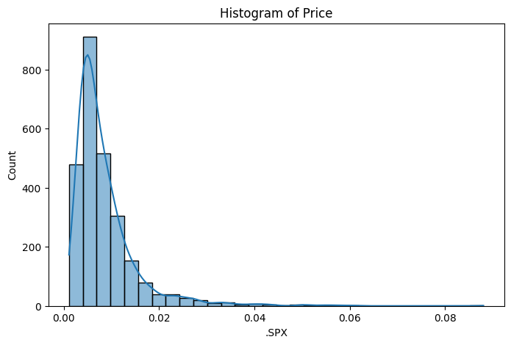
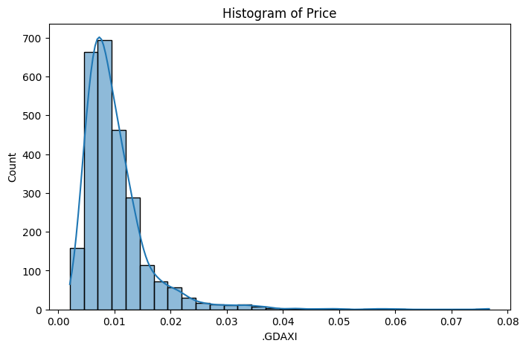
Normality Tests
The realized variance series data does not fit a normal distribution.

Slide 9
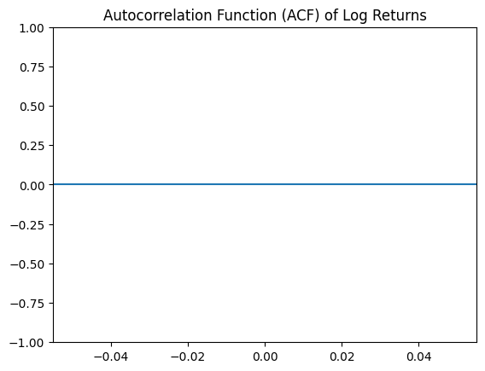
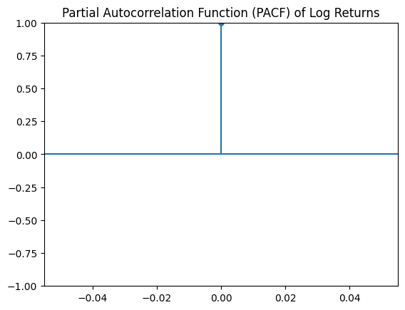
No significant autocorrelation
Autocorrelation tests on Log Returns

Slide 10
Pearson Correlation Test Between Return and RV
Ticker | Pearson Correlation
SPX | -0.338604
GDAXI | -0.035292
FCHI | 0.211963
FTSE | 0.397545
OMXSPI | -0.429171
N225 | -0.255845
KS11 | -0.166977

Slide 11
Data: look for recent stock price data and options data with implied volatility
Model training: fit model to dataset
Strategy Implementation: Backtest strategy on options data
Analyze Results
Future Directions

